Slide 1
Machine Learning from Disaster
07/2025
Marcus Lui

Slide 2
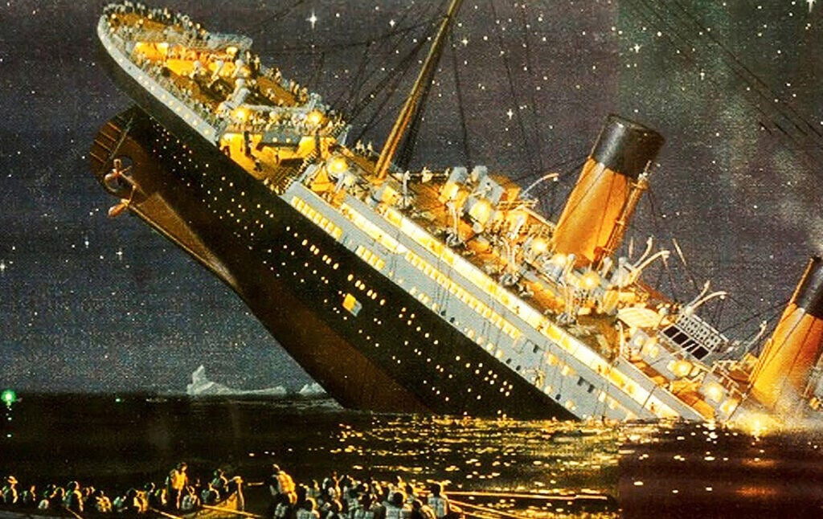
The Titanic
Great movie
Marketed as the “Unsinkable Ship”
Sunk during maiden voyage in 1912
1502/2224 passengers did not survive
32% Survival rate

Slide 3




Kaggle Competition
Build a predictive model that answers the question: What sorts of people are more likely to survive?
Process the data
Clean
and build
Predict
and Submit
titanic_train
titanic_test
Data cleaning
Model creation and tuning
Generate survivability for titanic_test and submit predictions

Slide 4
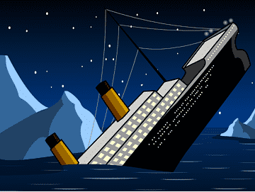
Could I survive the Titanic?

Slide 5
The Data
2 datasets from www.kaggle.com/competitions/titanic
Used python and jupyter notebooks to perform analysis and create ML models
891 (40%) training entries and 418 (19%) test entries

Slide 6
More Data
Features:
Passenger ID, Passenger class, Name, Sex, Age, Number of Siblings and Spouses, Number of Parent and Children, Ticket Number, Ticket Fare, Cabin Number, Embark location
Both datasets needed cleaning and processing
1279 null values in total
Age, Embarked, Cabin

Slide 7
Women are more likely to survive than men
Hypotheses:
Solo travelers are more likely to survive
1st class passengers are significantly more likely to survive compared to 2nd and 3rd class passengers
Survivability increases as ticket cost increases

Slide 8
Hypothesis #1
Women are more likely to survive than men

Slide 9
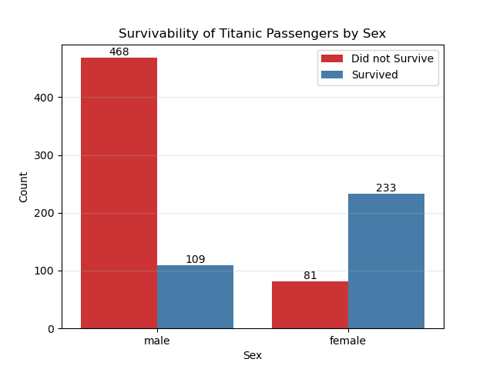
Conclusion #1
Women are 55% more likely to survive than men
19% Male survival rate
74% Female survival rate
Notes:
19% male survival
74% female survival

Slide 10
Hypothesis #2
Solo travelers are more likely to survive

Slide 11
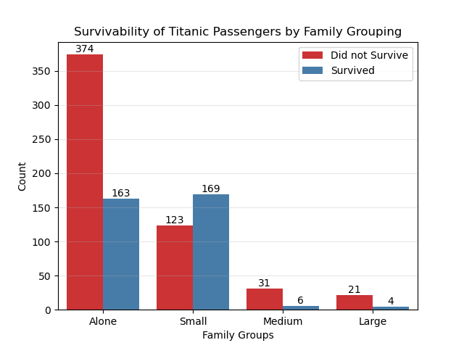
Conclusion #2
Passengers traveling in small groups are more likely to survive
Travel Size Survival Odds:
Solo (1): 30%
Small (2-4): 58%
Medium (5-6): 16%
Large (7-11): 16%
Notes:
Solo = 30%
Small = 58%
Medium and Large = 16%

Slide 12
Hypothesis #3
1st class passengers are significantly more likely to survive compared to 2nd and 3rd class passengers

Slide 13
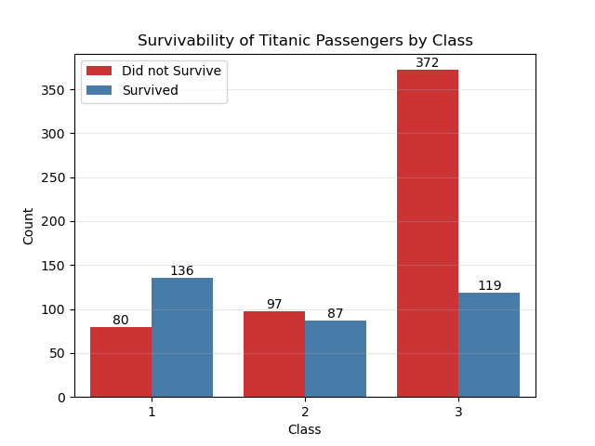
Conclusion #3
1st class passengers are 33% and 159% more likely to survive compared to 2nd and 3rd class passengers
1st: 62.96% survival rate
2nd: 47.28% survival rate
3rd: 24.23% survival rate

Slide 14
Hypothesis #4
Survivability increases as ticket price increases

Slide 15
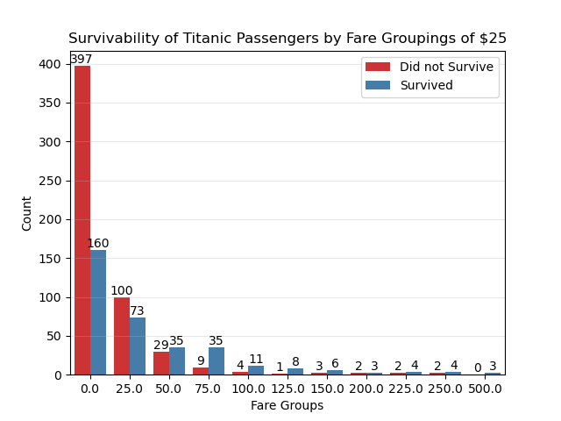
Conclusion #4
As ticket cost increases, so does survivability
Increased survival > £50

Slide 16
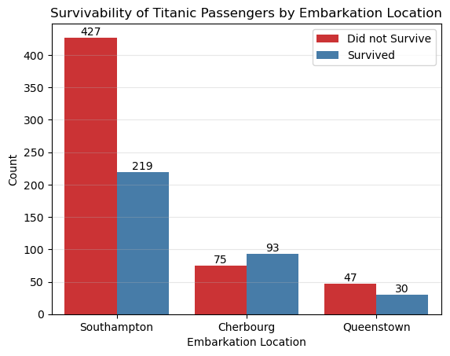
Additional Findings
Cherbourg survival: 56%
Southampton survival: 34%
Queenstown: 39%

Slide 17
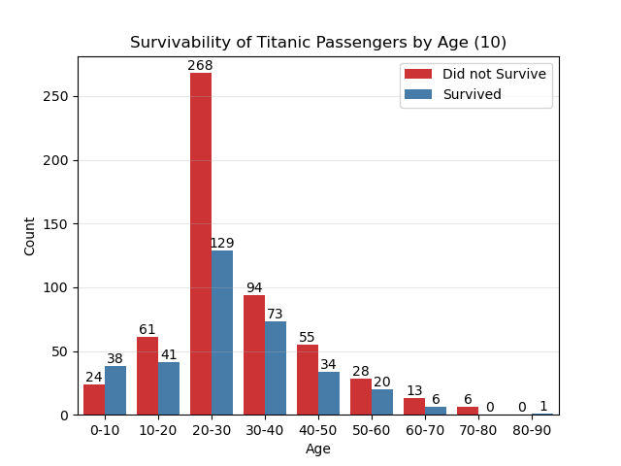
Additional Findings
Adults over 80 were most likely to survive
Children under 10: 61.29%

Slide 18
What we’ve gathered so far…
Survivors are more likely…
Female
Traveling in a group of 2-4
Higher class, and paid a higher priced ticket
Embarked from Southampton (64% of survivors)
Children under 10 had the highest chance of survival of any age group

Slide 19
6 Classification Models for predicting Titanic survivability
Logistic Regression (LR)
Random Forest (RF)
Decision Tree (DT)
K Nearest Neighbors (KNN)
Support Vector Classification (SVC)
Gaussian Naive Bayes (GNB)

Slide 20
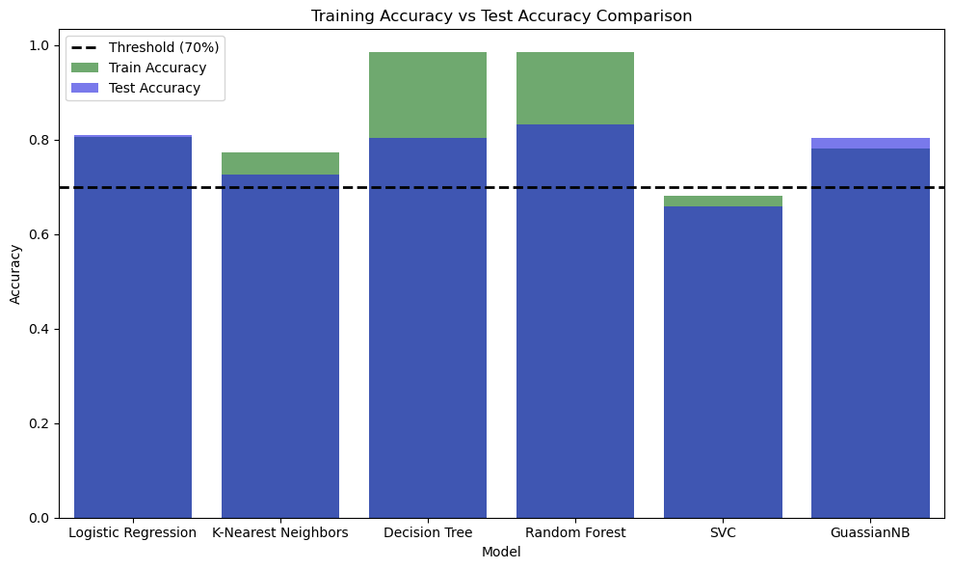
Training vs Test Accuracy
DT & RF 98.45% training accuracy
LR 81% highest test accuracy
SVC 68.1% train and 65.9% test

Slide 21
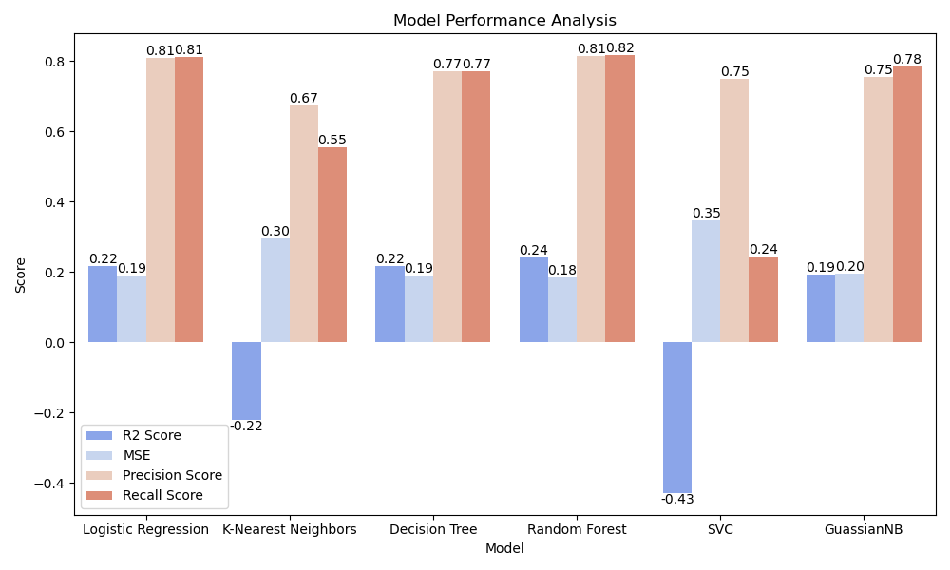
Model Performance
High R^2 score
Low MSE
High Precision Score
High Recall Score

Slide 22
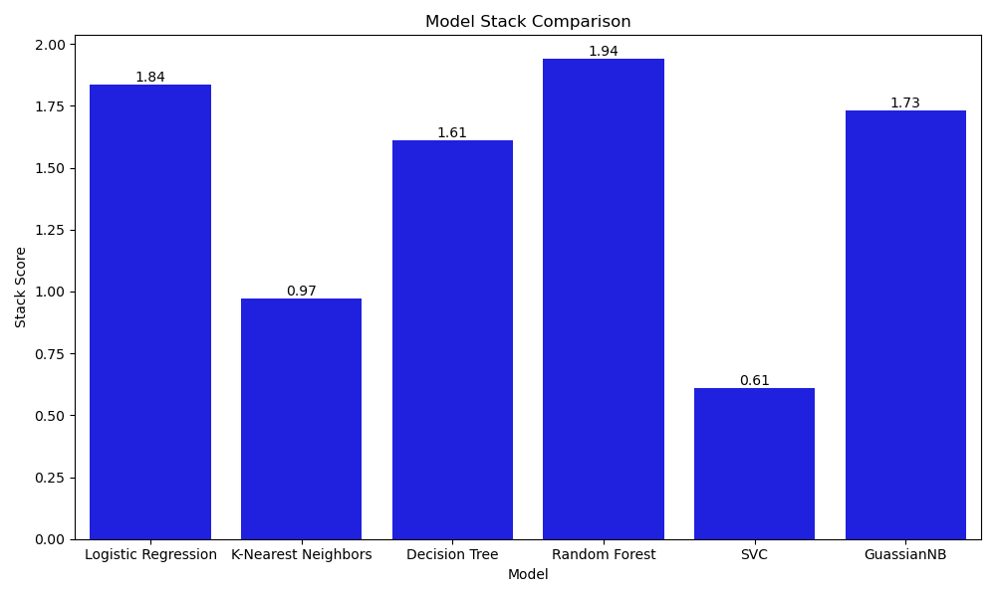
Model Performance
Random Forest
Logistic Regression
GaussianNB
Decision Tree
KNN
SVC

Slide 23
Training vs Test Accuracy
Ideal models perform between 70-90%
Large accuracy delta indicates overfitting

Slide 24
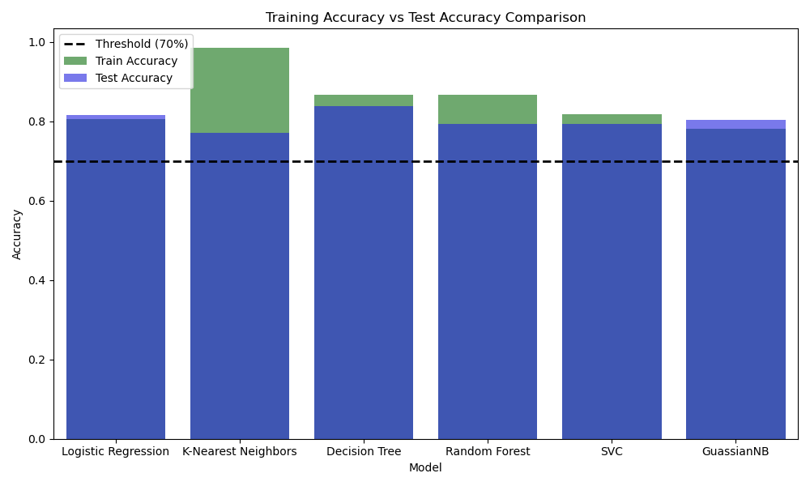
Enhanced Model Accuracy
KNN and SVC improved 5% and 13%
Average test accuracy 80%
DT highest

Slide 25
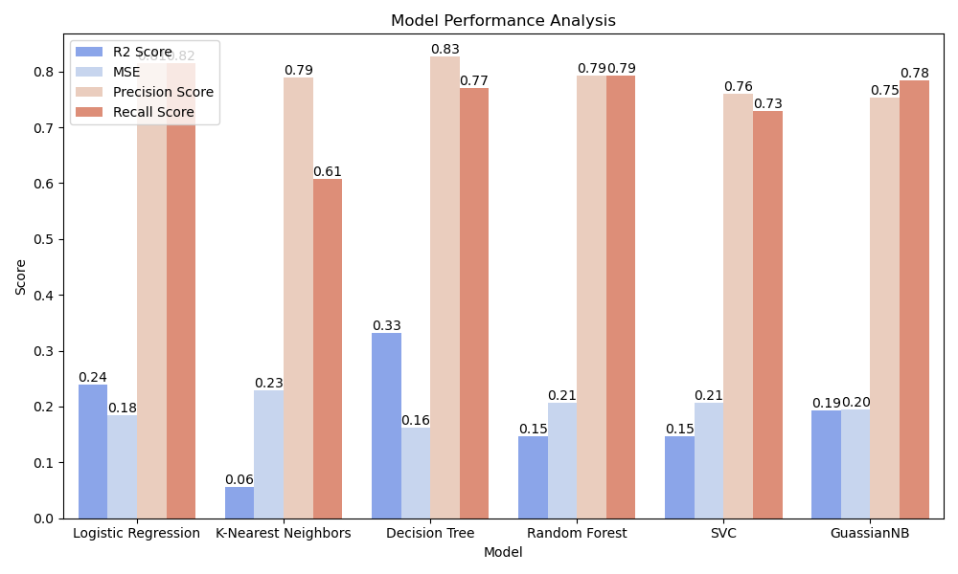
Model Enhancement
LR and DT
High R^2 and low MSE
KNN & SVC improved greatly

Slide 26
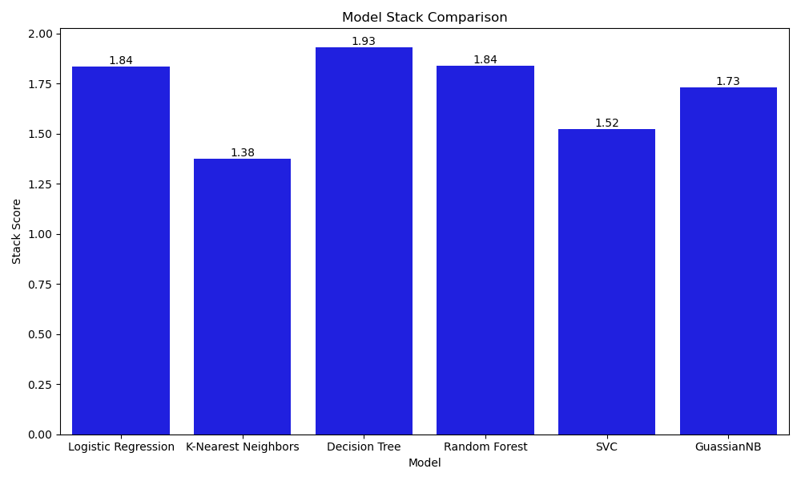
Model Performance
Decision Tree
Logistic Regression
Random Forest
GaussianNB
SVC
KNN

Slide 27
Logistic Regression: 77.511%
Random Forest: 77.033%
Average Model Score:
73.684%
Decision Tree: 75.598%
Support Vector Classification: 73.684%
Gaussian Naive Bayes: 72.248%
K Nearest Neighbors: 66.028%

Slide 28
Submission results were similar to model results
Stack Scoring
Decision Tree
Logistic Regression
Random Forest
GaussianNB
SVC
K-Nearest Neighbors
Competition Scoring
Logistic Regression
Random Forest
Decision Tree
SVC
GaussianNB
K-Nearest Neighbors

Slide 29

Can I survive?
Ran a couple simulations
83% Survivability as 1st class passenger
Otherwise 25%
Ticket cost increased survival rate
More likely to survive as a couple than a family
Embark location did not affect my survivability odds

Slide 30
Thank you

